Slide 1
Denial of Service (Ch 7)
Notes:
Thomas Finn
08 FEB 19

Slide 2
Denial of Service Attacks
Unlike other forms of computer attacks, goal isn’t access or theft of information or services
The goal is to stop the service from operating
To deny service to legitimate users
Slowing down may be good enough
This is usually a temporary effect that passes as soon as the attack stops

Slide 3
How Can a Service Be Denied?
Lots of ways
Crash the machine
Or put it into an infinite loop
Crash routers on the path to the machine
Use up a key machine resource
Use up a key network resource
Deny another service needed for this one (DNS)
Using up resources is the most common approach

Slide 4
Simple Denial of Service
One machine tries to bring down another machine
There is a fundamental problem for the attacker:
The attack machine must be “more powerful” than the target machine to overload it OR
Attacker uses approaches other than flooding, e.g., exploit vulnerability at the target
The target machine might be a powerful server
Hard to flood

Slide 5
DDoS – Distributed DoS
Use multiple machines to generate the workload
For any server of fixed power, enough attack machines working together can overload it
Enlist lots of machines and coordinate their attack on a single machine
Send any type of traffic, and the attack will work
If you want to be stealthy try to send traffic that looks like legitimate traffic

Slide 6

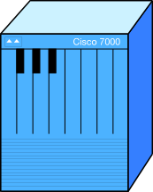

Distributed Denial-of-Service

Slide 7
Denial of Service and Asymmetry
Sometimes generating a request is cheaper than formulating a response
sending a bogus packet is cheaper than decrypting this packet and checking that it’s bogus
sending a request to a Web application is cheaper than generating a response via DB lookup
One attack machine can generate a lot of requests, and effectively multiply its power
Not always possible to achieve this asymmetry
This is called amplification effect

Slide 8
Denial of Service and IP Spoofing
Attacker can put a fake address in source IP field of the packets (IP spoofing)
Make packets appear to come from many sources
Make packets appear to come from a few select sources (and blame the attack on them)
Make packets appear to come one select source

Slide 9
Reflector Attack
Generate service requests to public servers spoofing the victim’s IP
Servers reply back to the victim overwhelming it
E.g., send DNS requests to DNS servers, they reply back to the victim
Usually requests use UDP and ICMP traffic
Often takes advantage of amplification effect
One service request leads to a huge reply or many replies
DNSSEC replies can be 200x larger than requests
Sending a ping packet to a broadcast address may lead to 253 replies back

Slide 10
High-level Attack Categorization
Floods
Exhaust bandwidth or CPU or some other limited resource
Congestion control exploits
Make legitimate traffic back off and take long time to ramp up
Unexpected header values, invalid content
Crash OS or application
Invalid fragments, large packets
Crash OS
Impersonation attacks
Take over the target’s DNS name or BGP prefix and draw all their inbound traffic to yourself

Slide 11
UDP or ICMP ECHO (Ping) Flood
Attacker sends lots of UDP or ICMP packets
Exhaust the bandwidth
Usually UDP and ICMP make a small part of inbound traffic
We could devise filters that would remove attack and some legitimate traffic (collateral damage)
Usually spoofed traffic

Slide 12
TCP SYN Flood
Attacker sends lots of TCP SYN packets
Victim sends an ack, allocates space in memory, attacker never replies
Goal is to fill up memory before entries time out and get deleted
Usually spoofed traffic, or else the attacker’s OS would send a RST and free up memory at the target

Slide 13
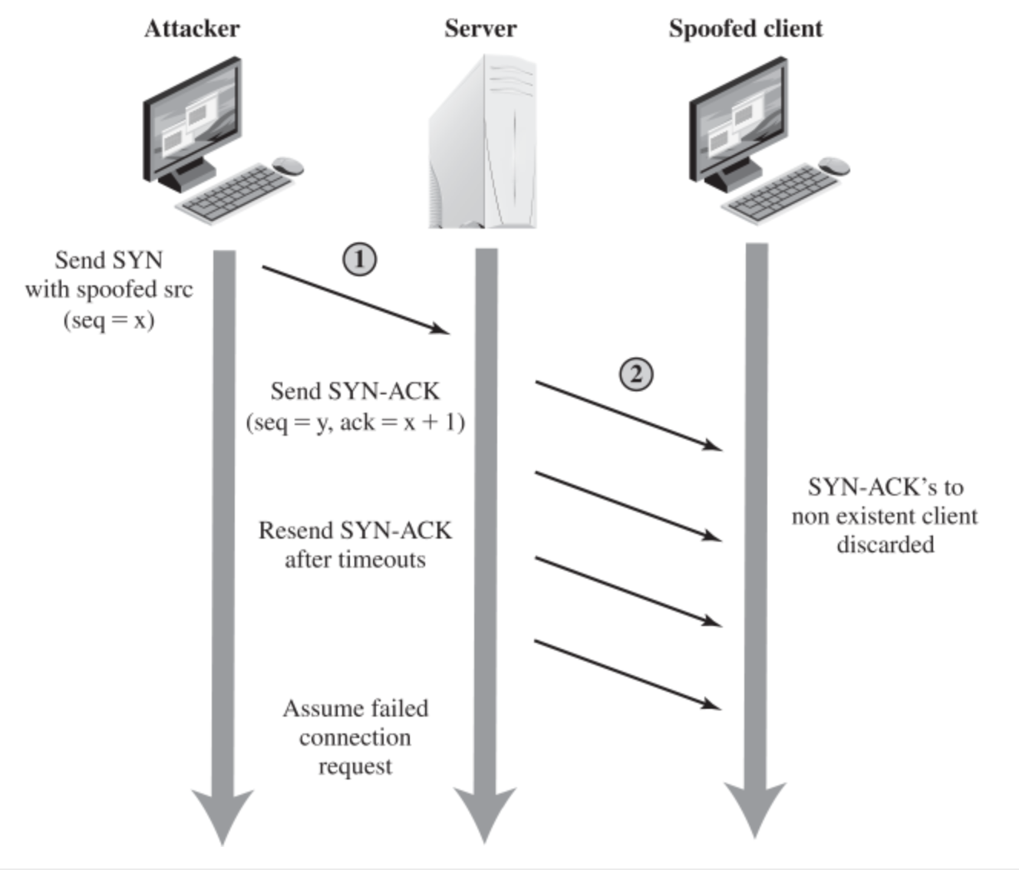
TCP SYN Flood

Slide 14
Small-Packet Floods
Overwhelm routers
Create a lot of packets per second
Exhaust CPU
Most routers can’t handle full bandwidth’s load of small packets
No real solution, must filter packets somehow to reduce router load

Slide 15
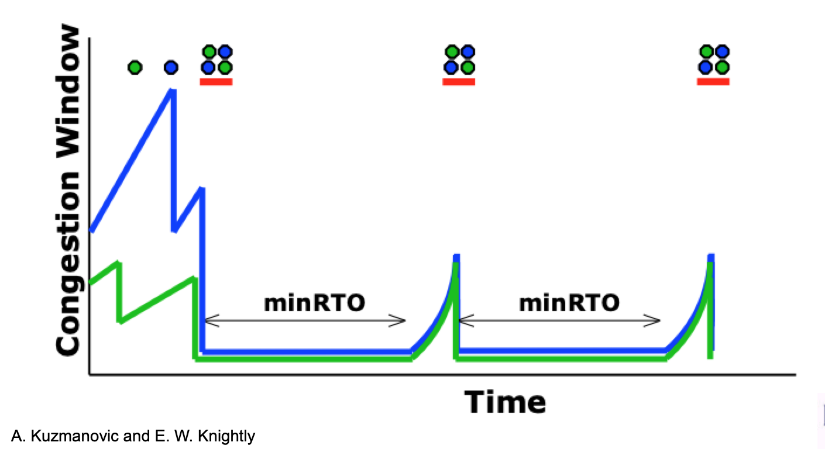
Shrew Attack
Periodically slam the victim with short, high-volume pulses
Lead to congestion drops on legitimate client’s TCP traffic
TCP backs off to 1 packet per RTT
Attacker slams again after a few RTTs
Solution requires TCP protocol changes
Tough to implement since all clients must be changed

Slide 16
Flash-Crowd Attack
Aka application-level flood
Generate legitimate application traffic to the victim
E.g., DNS requests, Web requests, SIP requests
Usually not spoofed but could be if traffic is over UDP
If enough bots are used no client appears too aggressive
Really hard to filter since both traffic and client behavior seem identical between attackers and legitimate users

Slide 17
But I Have a Firewall!
Doesn’t matter!
Either the attacker slips his traffic into legitimate traffic
Or he attacks the firewall

Slide 18
But I Use a VPN!
Doesn’t matter!
The attacker can fill your tunnel with garbage
Sure, you’ll detect it and discard it . . .
But you’ll be so busy doing so that you’ll have no time for your real work

Slide 19

But I’m Heavily Provisioned
Doesn’t matter!
The attacker can probably get enough resources to overcome any level of resources you buy

Slide 20
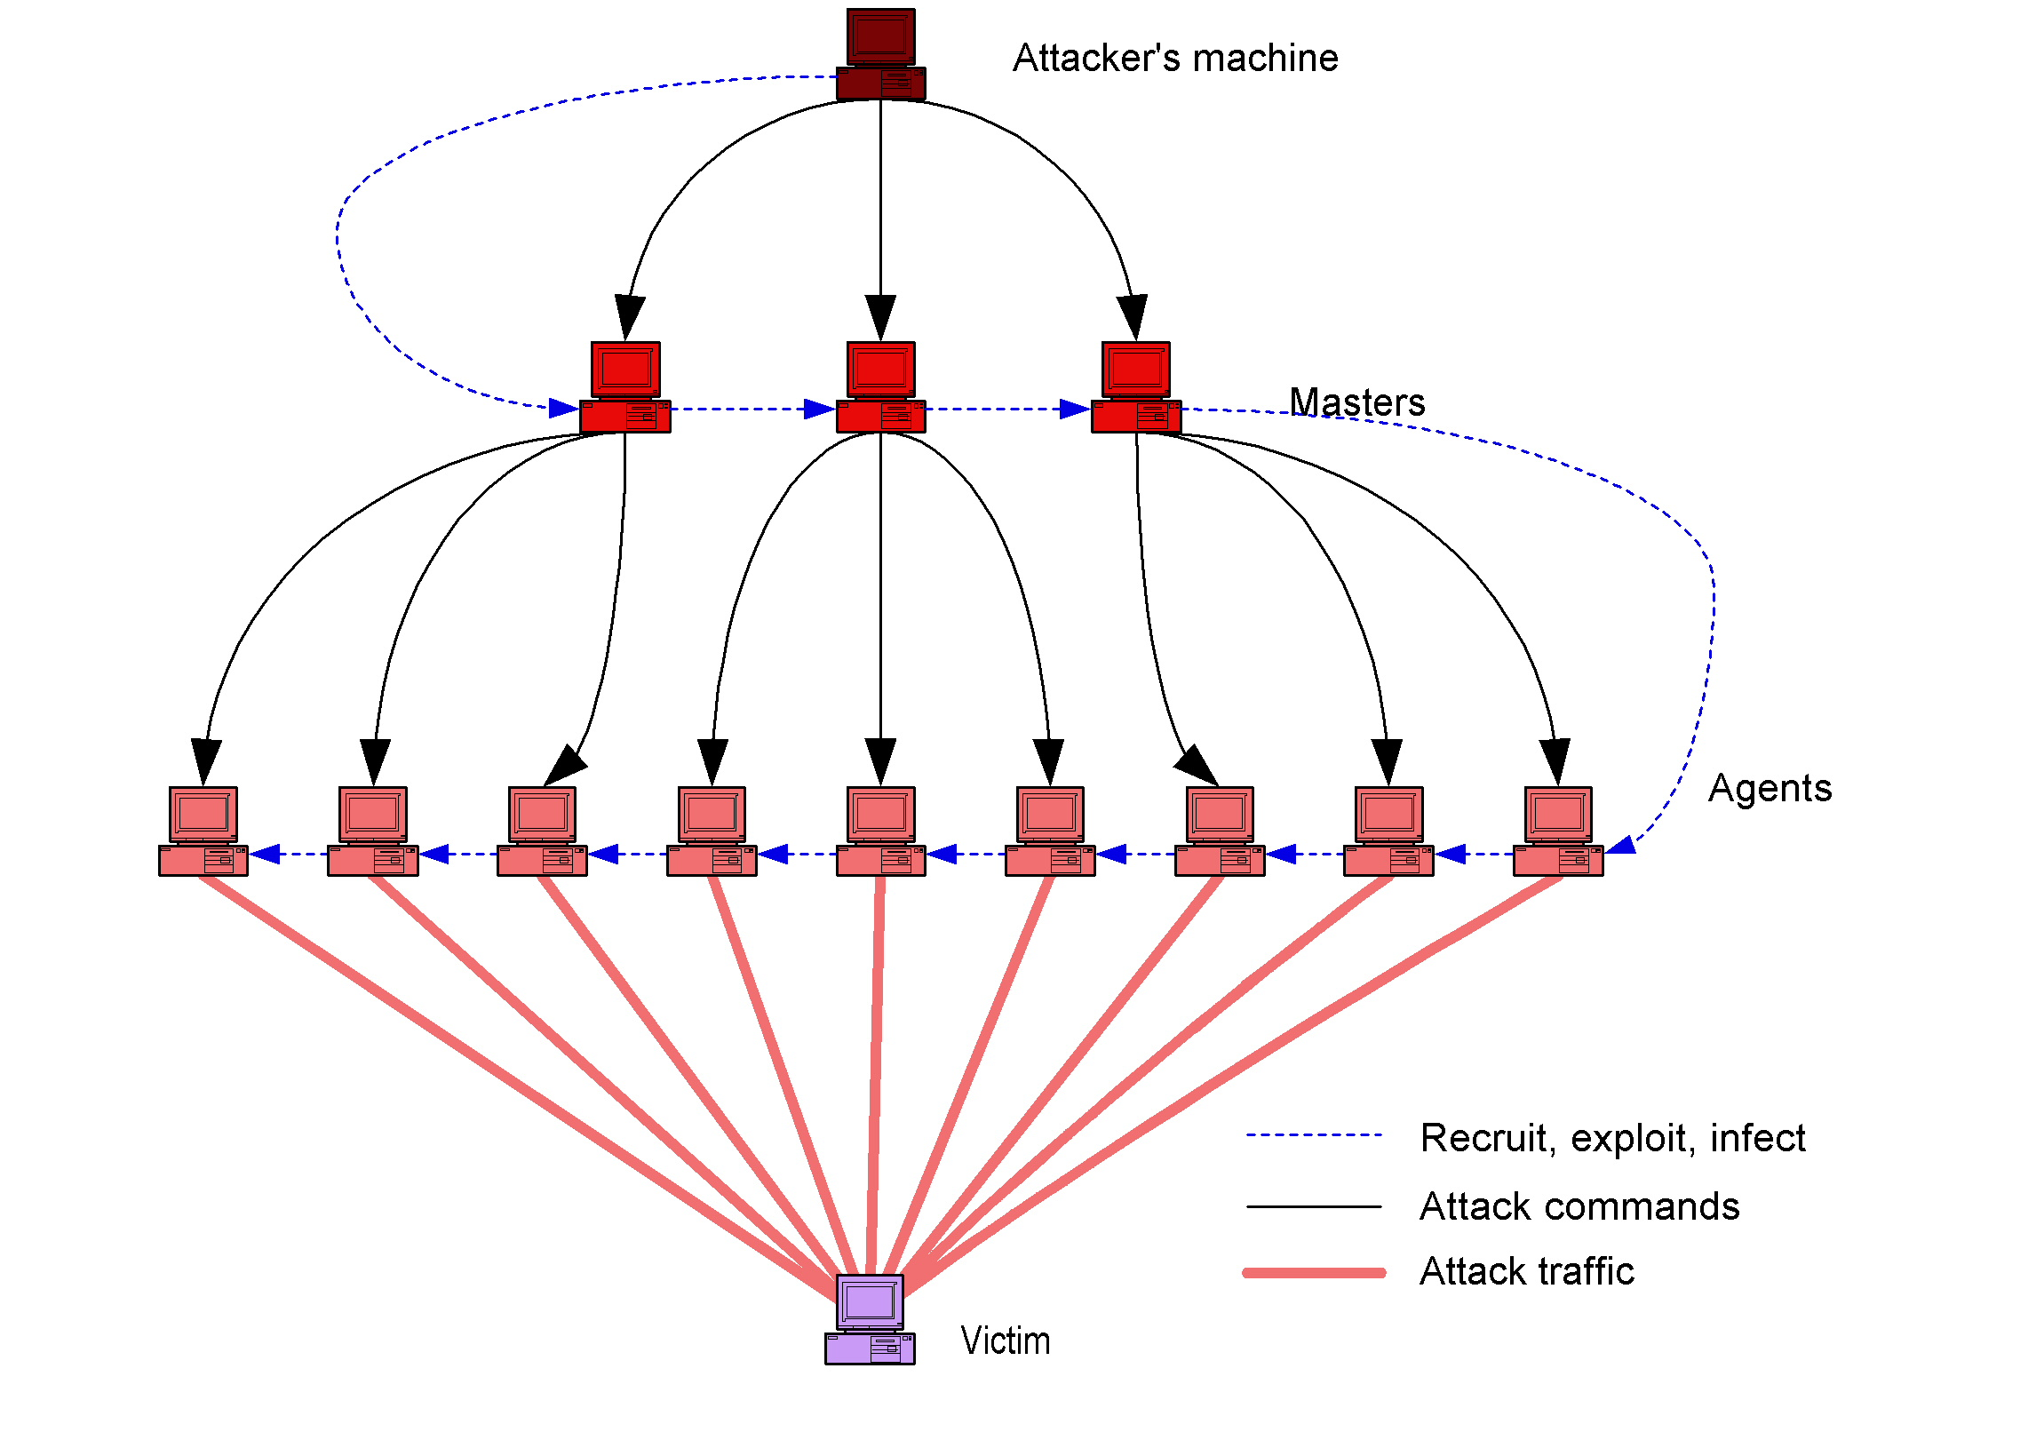
Typical Attack Modus Operandi

Slide 21
Attack Toolkits
Widely available on the net
Easily downloaded along with source code
Easily deployed and used
Automated code for:
Scanning – detection of vulnerable machines
Exploit – breaking into the machine
Infection – placing the attack code
Rootkits
Hide the attack code, restart it
Keep open backdoors for attacker access
DDoS attack code

Slide 22
DDoS Attack Code
Attacker can customize:
Type of attack
UDP flood, ICMP flood, TCP SYN flood, Smurf attack (broadcast ping flood)
Web server request flood, authentication request flood, DNS flood
Victim IP address
Duration
Packet size
Source IP spoofing
Dynamics (constant rate or pulsing)
Communication between master and slaves (used to be via custom protocol, then via IRC, nowadays via P2P or stealthy messages to Web servers)

Slide 23

Try To DoS A Server
Log on to DeterLab and then log on to
attacker.exp[1-4].USC430
Try wget server
Can you get a reply?
Now try the following command:
flooder --dst 10.1.2.2 –highrate 1000000
Try wget server again
Can you get a reply?
Notes:
To view traffic: tcpdump -i eth0 -tt -nn

Slide 24
Why Is DDoS Hard to Solve?
A simple form of attack
Designed to prey on the Internet’s strengths
Easy availability of attack machines
Attack can look like normal traffic
Lack of Internet enforcement tools
Hard to get cooperation from others
Effective solutions hard to deploy

Slide 25
1. Simplicity Of Attack
Basically, just send someone a lot of traffic
More complicated versions can add refinements, but that’s the crux of it
No need to find new vulnerabilities
No need to worry about timing, tracing, etc.
Toolkits are readily available to allow the novice to perform DDoS
Even distributed parts are very simple

Slide 26
2. Preys On Internet’s Strengths
The Internet was designed to deliver lots of traffic
From lots of places, to lots of places
DDoS attackers want to deliver lots of traffic from lots of places to one place
Any individual packet can look proper to the Internet
Without sophisticated analysis, even the entire flow can appear proper

Slide 27
Internet Resource Utilization
Internet was not designed to monitor resource utilization
Most of it follows first come, first served model
Many network services work the same way
And many key underlying mechanisms do, too
Thus, if a villain can get to the important resources first, he can often deny them to good users

Slide 28
3. Availability Of Attack Machines
DDoS is feasible because attackers can enlist many machines
Attackers can enlist many machines because many machines are readily vulnerable
Not hard to find 1,000 crackable machines on the Internet
Particularly if you don’t care which 1,000
Botnets numbering hundreds of thousands of hosts have been discovered

Slide 29
Can’t We Fix These Vulnerabilities?
DDoS attacks don’t really harm the attacking machines
Many people don’t protect their machines even when the attacks can harm them
Why will they start protecting their machines just to help others?
Altruism has not yet proven to be a compelling argument for for network security

Slide 30
4. Attacks Resemble Normal Traffic
A DDoS attack can consist of vast number of requests for a web server’s home page
No need for attacker to use particular packets or packet contents
So neat filtering/signature tools may not help
Attacker can be arbitrarily sophisticated at mirroring legitimate traffic
In principle
Not often done because dumb attacks work so well

Slide 31
5. Lack Of Enforcement Tools
DDoS attackers have never been caught by tracing or observing attack
Only by old-fashioned detective work
Really, only when they’re dumb enough to boast about their success
The Internet offers no help in tracing a single attack stream, much less multiple ones
Even if you trace them, a clever attacker leaves no clues of his identity on those machines

Slide 32
What Is the Internet Lacking?
No validation of IP source address (allows spoofing)
No enforcement of amount of resources used
No method of tracking attack flows
Or those controlling attack flows
No method of assigning responsibility for bad packets or packet streams
No mechanism or tools for determining who corrupted a machine

Slide 33
6. Poor Cooperation In the Internet
It’s hard to get anyone to help you stop or trace or prevent an attack
Even your ISP might not be too cooperative
Anyone upstream of your ISP is less likely to be cooperative
ISPs more likely to cooperate with each other, though
Even if cooperation occurs, it occurs at human timescales
The attack might be over by the time you figure out who to call

Slide 34
7. Effective Solutions Hard To Deploy
The easiest place to deploy defensive systems is near your own machine
Defenses there might not work well (firewall example)
There are effective research solutions
But they require deployment near attackers or in the Internet core
Or, worse, in many places
A working solution is useless without deployment
Hard to get anything deployed if deploying site gets no direct advantage

Slide 35
Defenses Against DDoS
A few operational defenses in use today
Many research defenses
Not in active use
Some require large changes to the Internet and may never be in use
DDoS is still a big problem that is costly to solve
We look next into big categories of defense approaches
Many solutions in each category

Slide 36
Resource Limitations
Don’t allow an individual attack machine to use many of target’s resources
Each client gets a fair share
Requires:
Authentication (establish client identity), or
Making the client do some work first to “pay” for service
Authentication is hard if there is IP spoofing
Could be possible if TCP is used
Or we need separate authentication solution
Existing clients must be changed to handle special work

Slide 37
Hiding From the Attacker
Make it hard for anyone but legitimate clients to deliver messages at all
E.g., keep server’s identity obscure
A possible solution for some potential targets
But not for others, like public web servers
To the extent that approach relies on secrecy, it’s fragile
Security through obscurity

Slide 38
Resource Multiplication
As attacker demands more resources, supply them
Essentially, never allow resources to be depleted
Not always possible, usually expensive
Not clear that defender can keep ahead of the attacker
But still a good step against limited attacks
This is a large part of today’s operational solutions
Large clouds with lots of bandwidth and processing power

Slide 39
Trace and Stop Attacks
Figure out which machines attacks come from
Go to those machines (or near them) and stop the attacks
Tracing is trivial if IP source addresses aren’t spoofed
Tracing may be possible even if they are spoofed, but it is much harder
May not have ability/authority to do anything once you’ve found the attack machines
Not too helpful if attacker has a vast supply of machines

Slide 40
Filtering Attack Streams
The basis for most defensive approaches
Addresses the core of the problem by limiting the amount of work presented to target
Key question is:
What do you drop?
Good solutions drop all (and only) attack traffic
Less good solutions drop some (or all) of everything

Slide 41
Filtering Vs. Rate Limiting
Filtering drops packets with particular characteristics
If you get the characteristics right, you do little collateral damage
At odds with the desire to drop all attack traffic
Rate limiting drops packets on basis of amount of traffic
Can thus assure target is not overwhelmed
But may drop some good traffic
You can combine them
Drop traffic for which you are sure is suspicious, rate-limit the rest

Slide 42
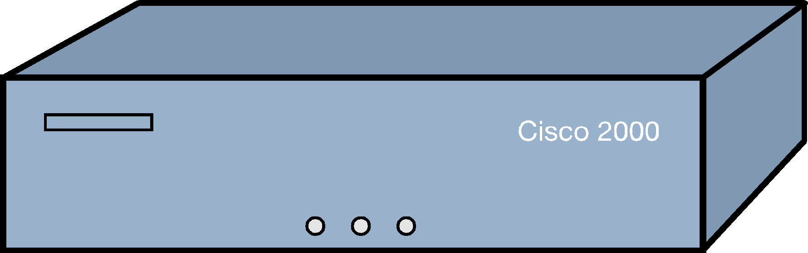
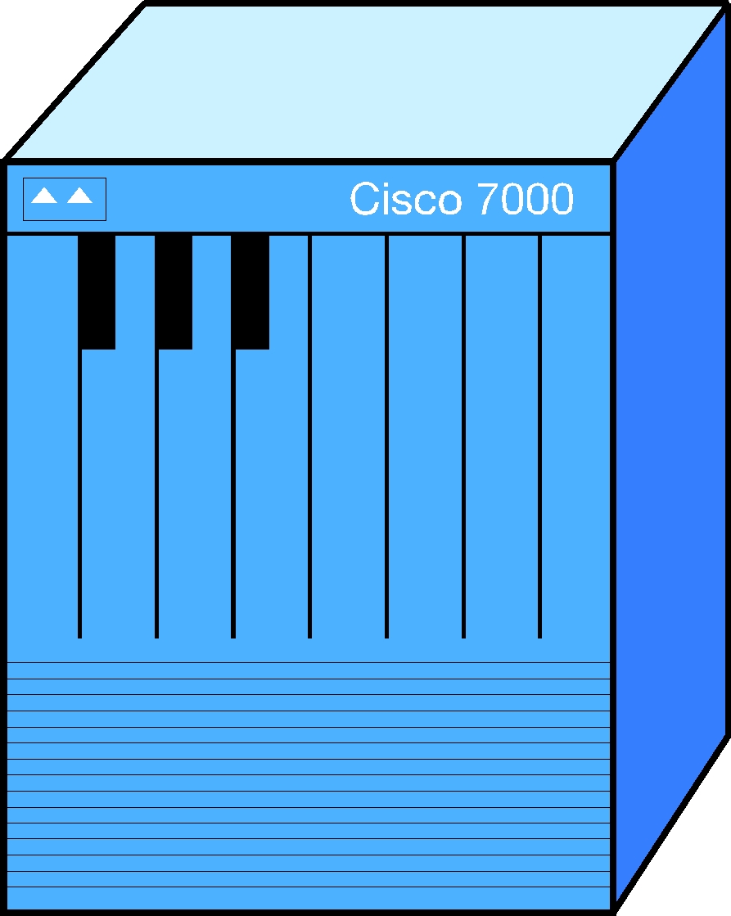
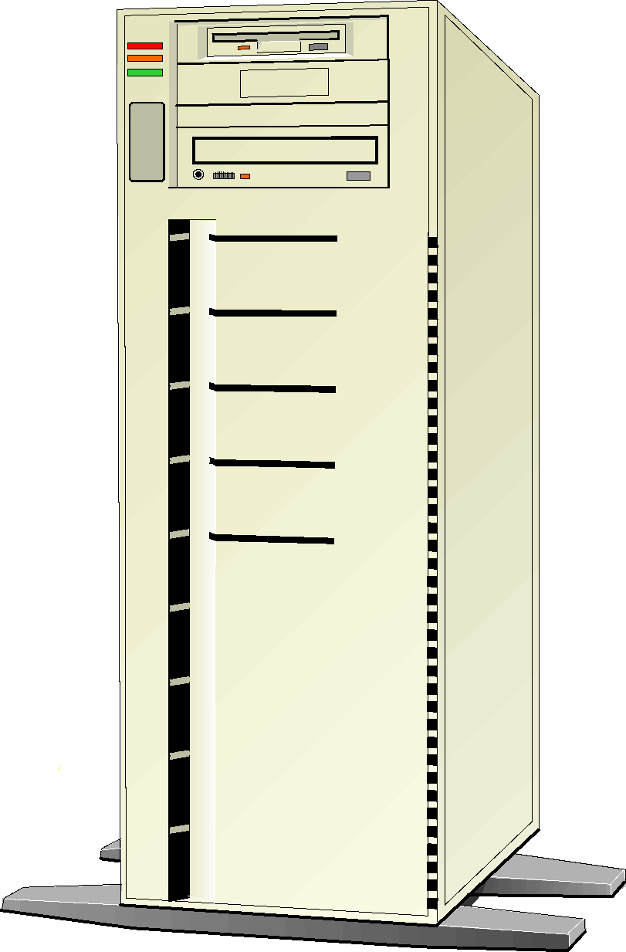
Where Do You Filter?
Near source
In core
Near the target

Slide 43
Filtering Location Choices
Near target
Easier to detect attack
Sees everything
May be hard to prevent collateral damage
May be hard to handle attack volume
Near source
May be hard to detect attack
Doesn’t see everything
Easier to prevent collateral damage
Easier to handle attack volume
In core
Easier to handle attack volume
Sees everything (with sufficient deployment)
May be hard to prevent collateral damage
May be hard to detect attack

Slide 44
How Do You Detect/Filter Attacks?
Have database of attack signatures
Detect anomalous behavior
By measuring some parameters for a long time and setting a baseline
Detecting when their values are abnormally high
By defining which behavior must be obeyed starting from some protocol specification
Devise filters that encompass most of anomalous traffic
Drop everything but give priority to legitimate-looking traffic
It has some parameter values
It has certain behavior

Slide 45
DDoS Defense Challenges
Need for a distributed response
Economic and social factors
Lack of detailed attack information
Lack of defense system benchmarks
Difficulty of large-scale testing
Moving target

Slide 46
Operational Defenses
Local device
Collect lots of statistics, learn baseline
Look for signatures or anomalies as signs of attack
Figure out what traffic is anomalous and filter it
Remote-triggered black hole (RTBH)
A network under attack asks its ISP in automated way to blackhole all traffic to a given prefix
Cloud-based defense
Distributed data-processing centers
Divert all of the target’s inbound traffic to the processing centers (distribute) and then analyze it there and remove attacks
Predominantly signature-based filtering
Send clean traffic back to the target

Slide 47
TCP SYN Cookies
Effective defense against TCP SYN flood
Victim encodes the information that would be saved in the connection table into the SEQ number for the server
SEQ = hash(information, server secret)
Memory is only reserved when final ACK comes and we check that it matches hash(information, server secret)+1
Only the server must change
But TCP options are not supported
And lost SYN ACKs are not repeated

